Slide 1
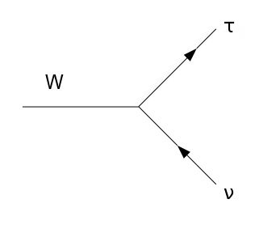
Analysing pp $→$W$→τν_{τ}$ events using HepMCAnalysis Tool.
Marc Sangel
Supervisor: Sebastian Johnert
DESY Summer Student Programm
Hamburg, DESY, 02. September 2011

Slide 2
Outline
Analysis Chain
HepMCAnalysis Tool
Results for different Generators
Results for different PDFs
Summary
Efficiencies

Slide 3
Introduction

Slide 4
Analysis Chain
LHC
Search for new physics and particles
Data
Understanding signal and background processes
Simulation
Comparison with data

Slide 5
HepMCAnalysis Tool

Slide 6
HepMC Format
Graph structure of physics event
HepMC format: vertex and particle structure
Particles: kinematic information, ID, …
Each particle belongs at least to one vertex

Slide 7
HepMCAnalysis tool
What is the HepMCAnalysis tool ?
Framework for Monte Carlo generator validation and comparison
requirements
Hardly dependency on other software packages
Covers different aspects of event generation: hard process, UE, multiple parton interaction
Covers many physics processes like pp->Z, pp->ttbar, pp->W/Z +jets
User-friendly (many documentations, manuals, tutorials,…)
Simple extendable for user analysis

Slide 8
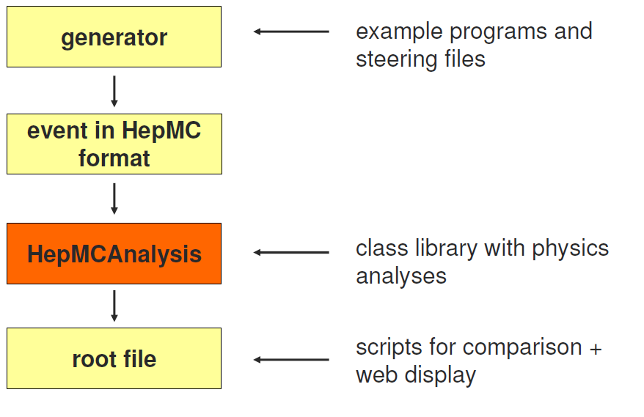
Workflow of HepMCAnalysis

Slide 9
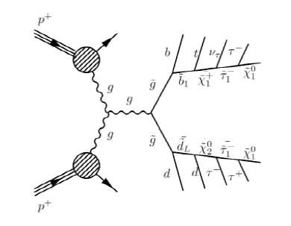
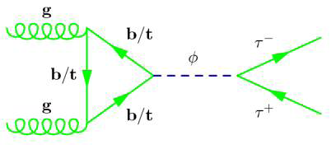
Why is pp$→$W $→τν_{τ}$ interesting?
LHC: Find new physics like Higgs or physics beyond the SM (SUSY)
$τ$ particle plays important role in the final state of Higgs and SUSY
τ particle plays important role in the final state of Higgs and SUSY
Z$→ττ$ or W$→τν_{τ}$ important background process in Higgs and SUSY search
Z→ττ or W→τν_τ important background process in Higgs and SUSY search
σ(W$→τν_{τ}$)$≈10∗$σ(Z$→ττ$)
σ(W→τν_τ)≈10∗σ(Z→ττ)

Slide 10
Results

Slide 11
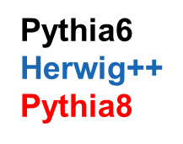
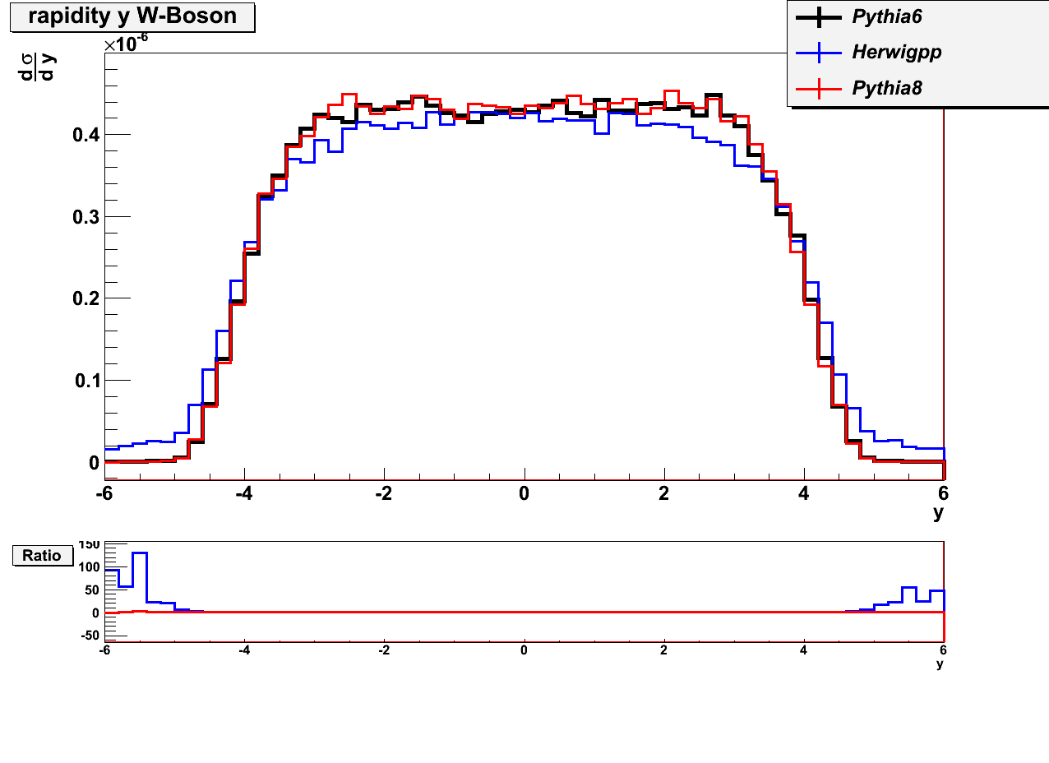
Results for different generators: W histograms
$p_{T}$(W)
Hardly differences between Pythia6 and Pythia8
Higher differences between Herwig++ and Pythia
Herwig++ does not decrease for first bin → will be checked
$$y(W)$$

Slide 12
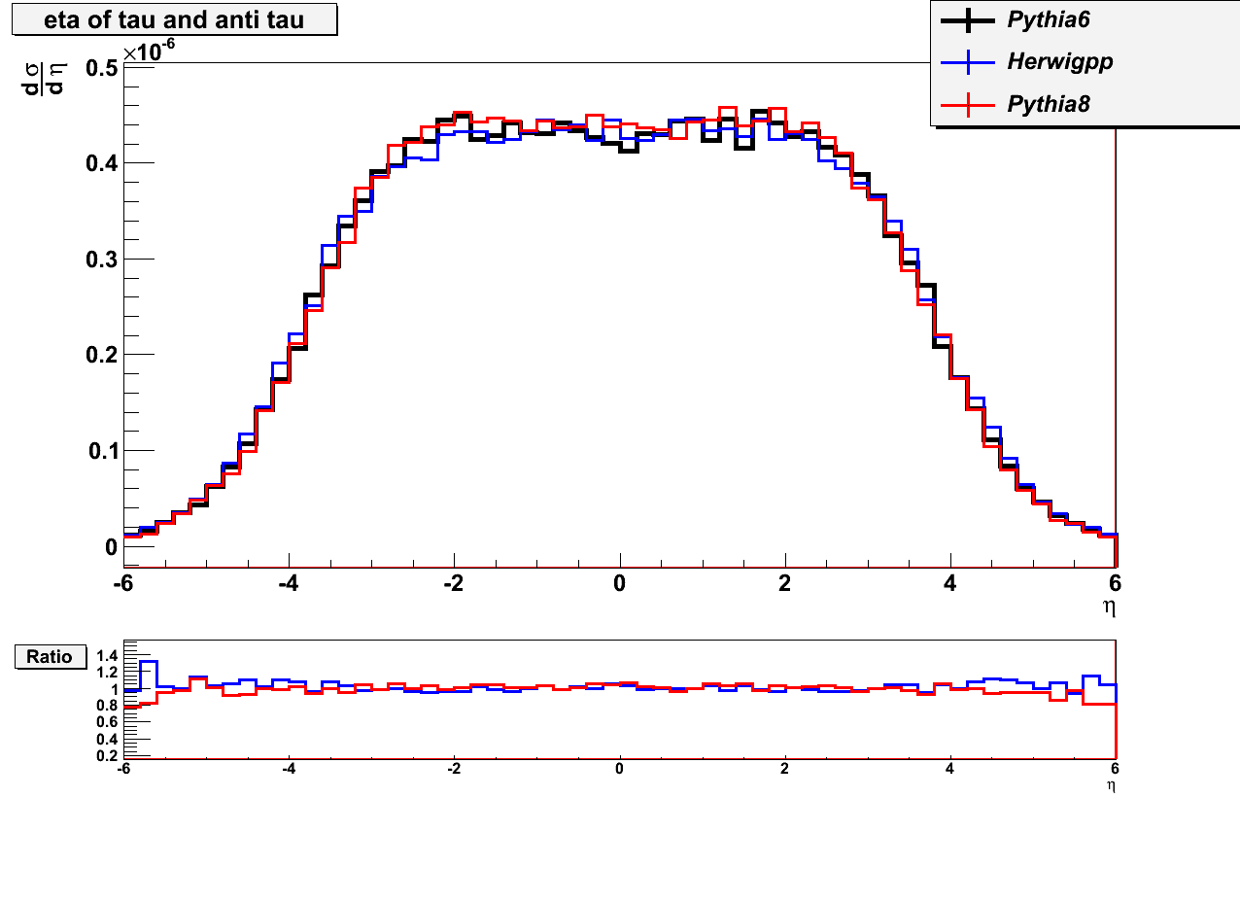
Results for different generators: $τ$ histograms
$$p_{T}(τ)$$
Pythia6
Herwig++
Pythia8
No significant deviations between generators for $τ$ histograms
Highest deviation: Herwig++
$η≔$-ln(tan($\frac{θ}{2}$))
$$η(τ)$$

Slide 13
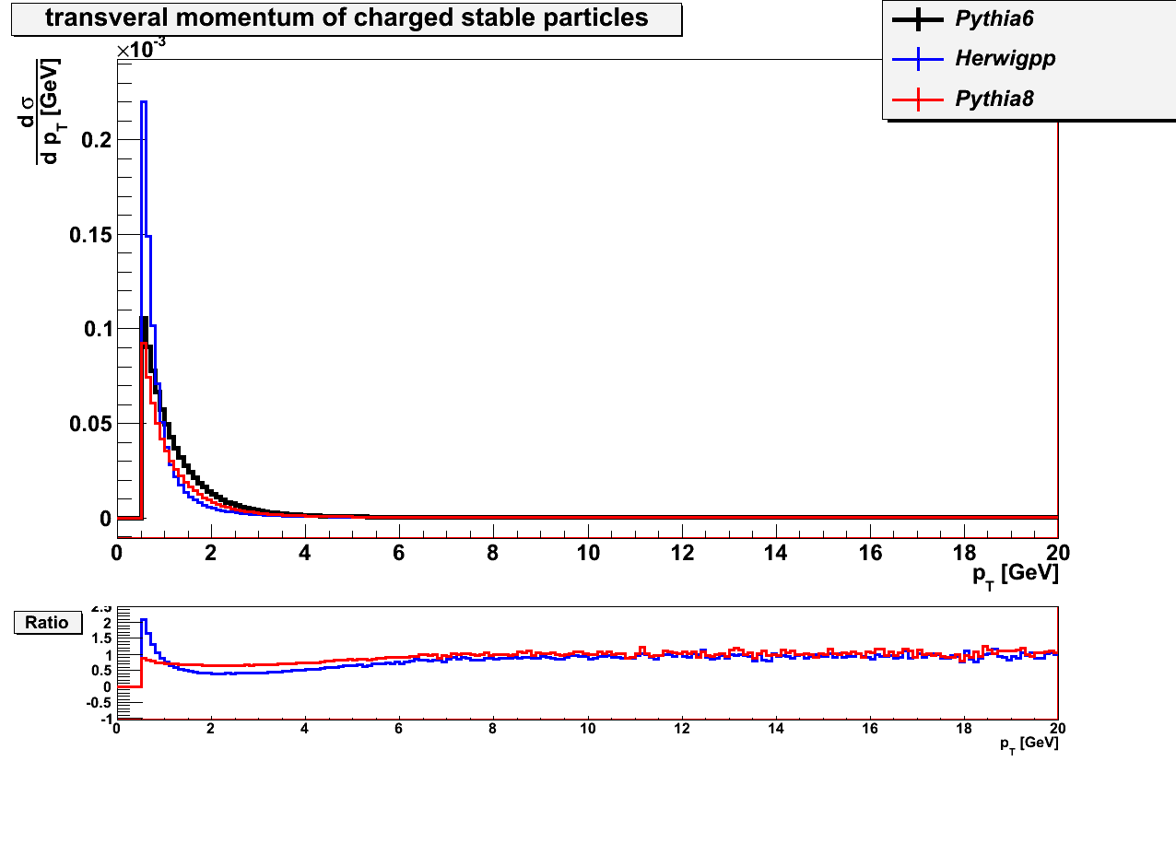
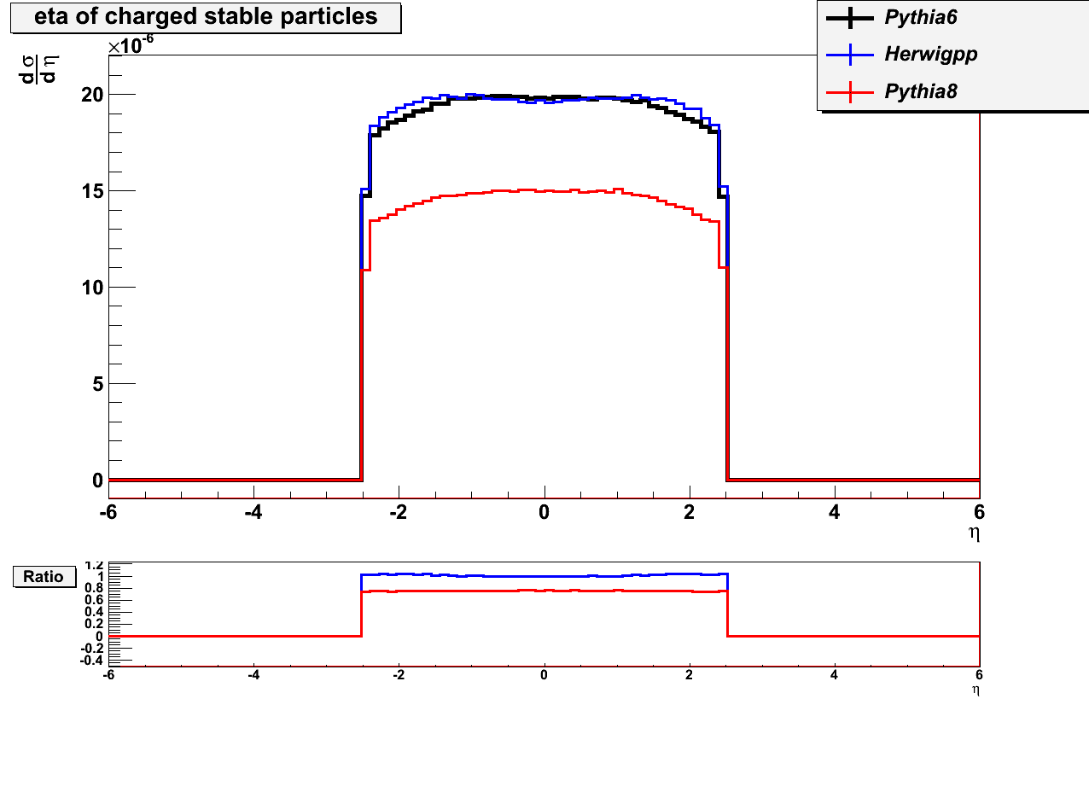
Results for different generators: charged stable particles
number
peculiar behaviour of Pythia 8
Pythia 6 and Herwig++ very similar
Pythia6
Herwig++
Pythia8
$$p_{T}$$
$$η$$

Slide 14
Parton Distribution Functions (PDFs)
Usage of different orders
leading order (LO): MSTW2008lo90cl
What is modified leading order?
Want LO PDF to behave like NLO PDF
next to leading order (NLO): CTEQ66
next to next to leading order (NNLO): HERAPDF15NNLOEIG
modified leading order (LOmod): MRST2007lomod
Improvement of quality of LO global fit
Relaxing the momentum sum rule at input
Use NLO strong coupling for LO PDF

Slide 15
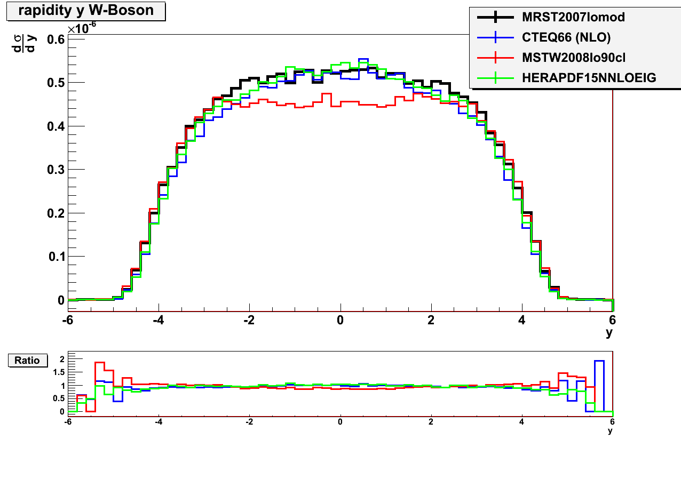
Results for Different PDFs: W histograms
$p_{T}$(W)
Good agreement of PDFs different orders for $p_{T}(W)$
Differences between LO and other PDFs in rapidity of W as expected
LOmod distributions close to NLO distributions
LO
NLO
NNLO
LOmod (LO*)
$$y(W)$$

Slide 16
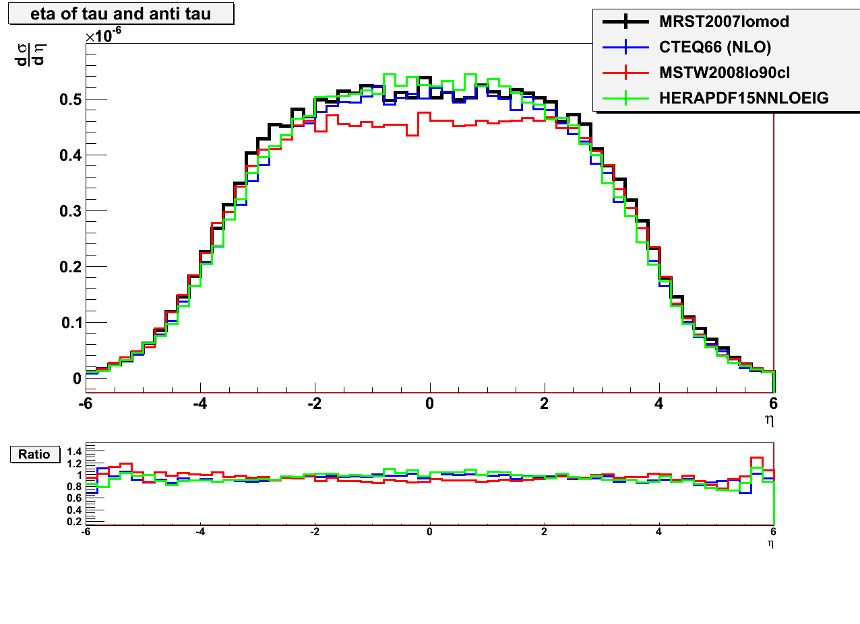
Results for different PDF: $τ$ histograms
Again good agreement of $p_{T}$ histograms
Behaviour as expected
LOmod gives good approximation of NLO
Similar results in arXive:0711.273v3 [hep-ph]
$$p_{T}(τ)$$
$$η(τ)$$
LO
NLO
NNLO
LOmod (LO*)

Slide 17
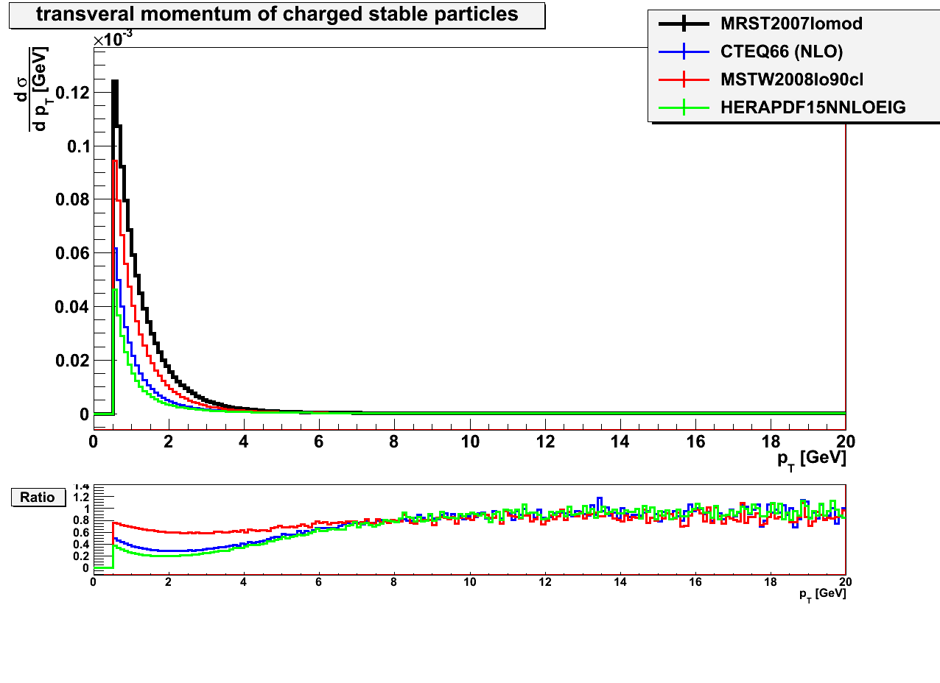
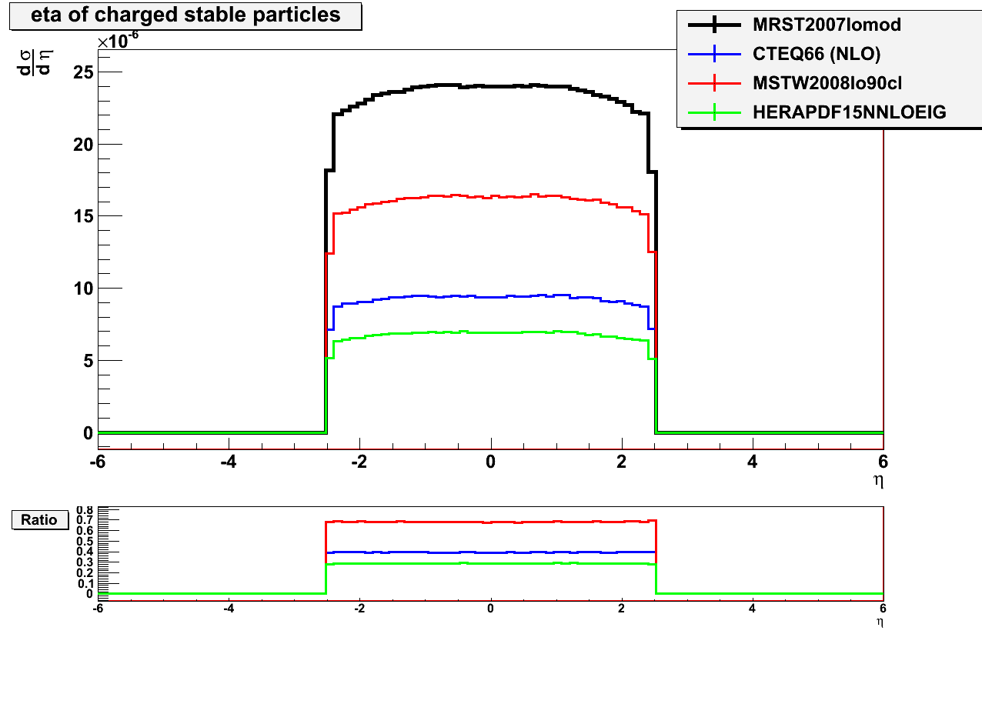
Results for different PDFs: Charged particles
number
Again big differences for charged particle histograms
$$p_{T}$$
LO
NLO
NNLO
LOmod (LO*)
$$η$$

Slide 18
Efficiency calculation
Due to technical constraints of ATLAS detector not all regions detectable$→$ acceptance region/acceptance calculation
Due to technical constraints of ATLAS detector not all regions detectable → acceptance region/acceptance calculation
20 GeV <$p_{T}\left(τ\right)$< 60 GeV
20 GeV < 𝑝_𝑇 (𝜏) < 60 GeV
Repeat this acceptance calculation independently from ATLAS using following cuts on generator level:
1.3 <| η$(τ)$| < 1.7 and | η$(τ)$| < 2.5
1.3 <| η(𝜏)| < 1.7 and | η(𝜏)| < 2.5
${(\sum{p^{ν})}}_{T}$> 30 GeV
〖(∑▒〖𝑝^ν)〗〗_𝑇 > 30 GeV
$∆φ\left(p^{τ},\sum{p^{ν}}\right)$ > 0.5
∆𝜑(𝑝^𝜏,∑▒𝑝^ν ) > 0.5

Slide 19
Results of efficiencies for different PDFs
For hadronically and leptonically decaying $τs$:
PDF | Efficiency | Error
MSTW2008lo90cl | 0.12762 | 0.00119961
CTEQ66 (NLO) | 0.13482 | 0.00123692
HERAPDF15NNLOEIG | 0.13427 | 0.00123409
MRST2007lomod | 0.13617 | 0.00124383
For hadronically decaying $τs$ only:
Decay ratio$≈0.6479$ (had/total)
PDF | Efficiency | Error
MSTW2008lo90cl | 0.08508 | 0.0008
CTEQ66 (NLO) | 0.08988 | 0.000825
HERAPDF15NNLOEIG | 0.089513 | 0.000823
MRST2007lomod | 0.09078 | 0.000829
ATLAS: Efficiency: 0.0975, Error: 0.0019; (arXive:1108.4101v1)

Slide 20
Summary
Significant differences between PDFs and Generators for charged particles histograms
Efficiency similar to ATLAS results
LOmod gives good approximation for NLO in $p_{T}$ histograms
LOmod gives good approximation for NLO in 𝑝_𝑇 histograms
Differences between LO and NLO PDFs
Analysis of pp$→$W$→τ_{ν}$
Analysis of pp→W→τ_ν
Similar deviations for different tunes

Slide 21
Backup

Slide 22
Class Library

Slide 23
Generators
Pythia
Hard process is calculated until leading order of parton distribution function
Herwig
Hard process also calculated until leading order
Connection between partons (strings), to avoid free quarks
All gluons decay in qqbar pairs.
All quarks are composed in color neutral objects

